Slide 1

Predico – Disease Prediction System
Presented By:
Prasuna Dash – 2301030048
Aman Pattanaik – 2301030051
B Raj Kumar Patro – 2301030023
Subham Rout – 2301030098
Aliva Priyadarshini Sahoo – 2301030069
Baijayanti Mahanta – 2301030125

Slide 2

Predico: AI-Powered Disease Prediction
Machine Learning Prediction
Online Doctor Consultations
Secure, Role-Based Access
Customized access for patients, doctors, and admins to protect data.
Analyze symptoms to predict diseases accurately and swiftly.
Users connect remotely with doctors via a secure telehealth platform.

Slide 3

The Problem: Reactive Healthcare
Delayed Medical Help
High Diagnosis Delays
Patients seek care only after symptoms worsen, risking complications.
Rare diseases take on average 4.8 years to diagnose worldwide.
Limited Healthcare Access
Rising Costs and Risks
45% of the global population lacks essential health services.
Late diagnosis means higher treatment costs and poorer outcomes.

Slide 4
Predico: Proactive Health Insights
AI-Powered Detection
Improved Outcomes
Telehealth Connection
Proven Accuracy
AI diagnostics improve accuracy by 26%, per 2023 study.
ML algorithms predict diseases early from symptom data.
Early diagnosis reduces cost and supports timely medical care.
Patients consult qualified doctors online seamlessly and securely.

Slide 5
Key Features
Symptom-Based Disease Prediction
Secure Video Consultations
Role-Based Access Control
Health Records & Notifications
Integrated Payment Gateway

Slide 6
Technology Stack
Backend – Django
Database – PostgreSQL
Machine Learning
Frontend & Hosting
Robust Python framework for rapid development.
Utilizes Scikit-learn and TensorFlow for predictions.
React UI with AWS cloud for security and scale.
Reliable and scalable data management.

Slide 7




User Roles
Patient
Input symptoms, get predictions, consult doctors, access records.
Doctor
Review data, provide diagnosis, conduct video consultations.
Admin
Manage platform, users, ML model updates, ensure HIPAA compliance.

Slide 8
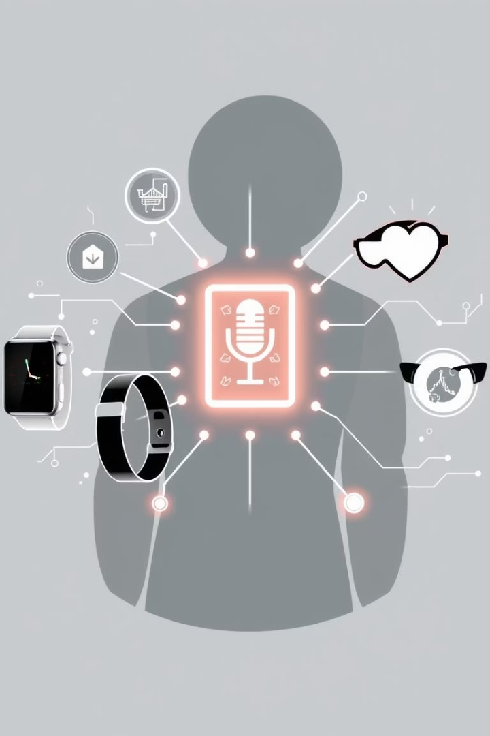




Future Roadmap
Voice-Based Input
Hands-free symptom entry for user convenience.
Wearable Integration
Continuous health monitoring for real-time data.
Real-World Deployment
Launch in clinics and hospitals for wider access.
Expanded AI Models
Broader disease coverage and personalized treatments.

Slide 9

Get Involved with Predico
Contact Us
Partner With Us
Learn more about Predico’s innovative solution.
Collaborate to improve healthcare accessibility worldwide.
Invest
Support our mission to revolutionize disease prediction.

